Slide 1
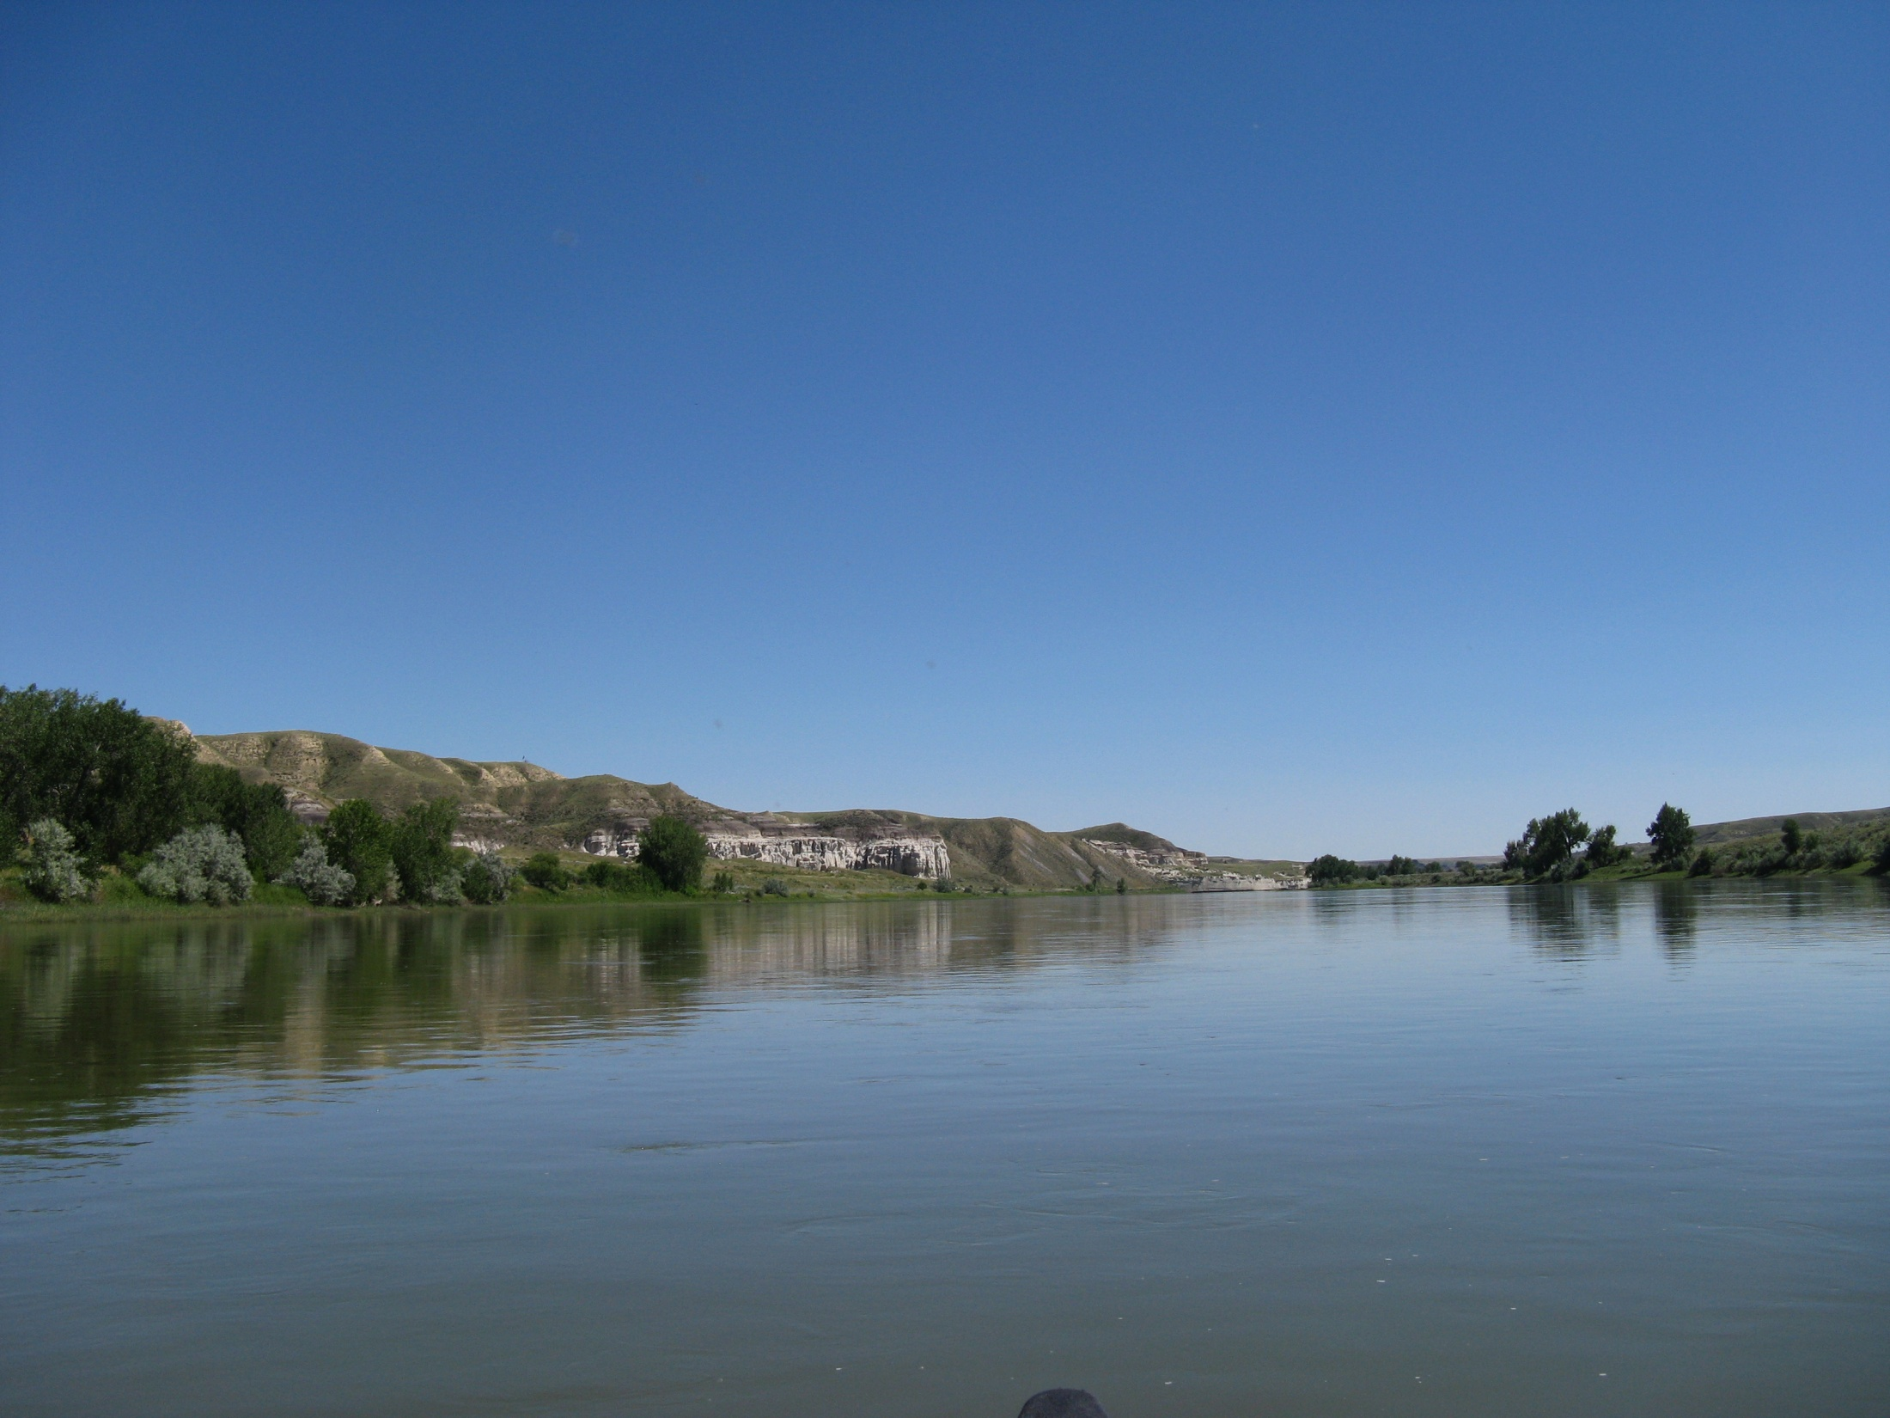
Tidelands, Shorelands & Riparian Boundaries
From the Book by the late Leroy Middleton, PLS, CHS
Power Point by James A. Coan, Sr., PLS, CFedS copyright © JACPLS 2012

Slide 2
Title to the beds of all navigable waters remained
in the United States until November 11, 1889,
after which title vested in the State of Washington,
with the exception of all Tidelands and Shorelands
patented by the United States prior to Statehood
(November 11, 1889)

Slide 3
In the State of Washington the courts have ruled
that where patents were issued by the United
States prior to statehood, if the waters are
navigable, the boundary is the line of ordinary
high tide (ordinary high water), or the Meander
line whichever is the lower one.

Slide 4
Where patents were issued by the United States
after statehood, the boundary goes to the line of
ordinary high tide (ordinary high water)
In the case of a river a pre-statehood patent takes
to the line of ordinary high water regardless of the
meander line.

Slide 5
The State of Washington under WAC 332-30-106
(40) which applies to the Department of Natural
Resources (WADNR) and to port districts defines
navigability as:

Slide 6
“ Navigability or navigable” means that a body of
water is capable or susceptible of having been or
being used for the transport of useful commerce.
The State of Washington considers all bodies of
water meandered by the government surveyors as
navigable unless otherwise declared by a court.

Slide 7
Effects of Statehood, November 11, 1889
UPLAND
BOUNDARY
GOV’T LOT 1
PATENTED - 1881
NAVIGABLE
UPLAND
BOUNDARY
GOV,T LOT 2
PATENTED - 1891
MEANDER LINE
WATER
LINE OF MEAN
HIGH TIDE

Slide 8
Definitions
First Class Tidelands – means the beds and
shores of navigable tidal waters belonging to the
State, lying within or in front of the corporate limits
of any city, and within one mile thereof upon each
side and between the line of ordinary high tide

Slide 9
and the inner harbor line, and within two
miles of the corporate limits on each side and
between the line of ordinary high tide and the
line of extreme low tide.

Slide 10
Definitions
Second Class Tidelands – means the public lands
belonging to the State over which the tide ebbs
and flows outside of and more than two miles from
the corporate limits of any city, from the line of
ordinary high tide to the line of extreme low tide.

Slide 11
Definitions
First Class Shorelands – Lands bordering on the
shores of navigable lakes or rivers not subject to
tidal flow, between the line of ordinary high water
and the line of navigability and within or in front of
the corporate limits of any city or within two miles
thereof on each side.

Slide 12
Definitions
Second Class Shorelands – Lands bordering on
the shores of a navigable lake or river not
subject to tidal flow, between the line of ordinary
high water and the line of navigability and more
than two miles from the corporate limits of any
city.

Slide 13
It should be noted that from 1895 to 1911 the
seaward boundary of tidelands were set at mean
low tide. Since 1911 the seaward limit has been
extreme low tide and the abutting tideland owner
who purchased prior to 1911 had the right to
purchase the area between mean low tide and
extreme low tide.

Slide 14
Line of Navigability – is the outer boundary of
Shorelands and is a indefinite term.
The State constitution provides or the establishment
of harbor lines in the navigable waters of the State,
wherever such navigable waters lie within or in front
of the corporate limits of any city, or within one mile
thereof on each side.

Slide 15
The harbor lines so established consist of:
Outer Harbor Line – The line beyond which the
State shall never sell or lease any rights.

Slide 16
Inner Harbor Line – The line located and
established in waters between the line of
ordinary high tide, or the line of ordinary high
water, and the outer harbor line and constituting the
inner boundary of the harbor area.

Slide 17
Waterway – A strip of land between the inner
and outer harbor lines which remains in public
use and cannot be sold of leased to provide
access from the uplands to the beds of navigable
waters.

Slide 18
Pierhead Line – A line established by the U.S. Army
Corps of Engineers beyond which there cannot be
any bulkhead or improvements and as a rule, these
lines are coincidental with the outer harbor line
established by the State.

Slide 19
Preferential Rights
1911
LOT 1
MEANDER
LOT 2
PREFERENTAL RIGHTS 1911
SECOND CLASS TIDELANDS
PRIOR TO 1911
PUGET SOUND
LOT 3
LINE
LOT 4
MEAN LOW TIDE
EXTREME LOW TIDE
MEAN HIGH TIDE

Slide 20
BEDS OF NAVIGABLE WATERS
PIERHEAD LINE
OUTER HARBOR LINE
HARBOR AREA
INNER HARBOR LINE
WATERWAY
EXTREME LOW TIDE
2ND CLASS TIDELANDS
FIRST CLASS TIDELANDS
2ND CLASS TIDELANDS
MEAN HIGH TIDE
1– MILE LIMIT
1 – MILE LIMIT
2 – MILE LIMIT
2 – MILE LIMIT
CITY LIMITS

Slide 21
2nd Class Tidelands:
2nd CLASS TIDELANDS
UPLANDS
WATER
LINE OF ORDINARY HIGH TIDE (MHT)
LINE OF EXTREME LOW TIDE
BEDS OF NAVIGABLE WATERS

Slide 22
2nd Class Shorelands:
2ND CLASS SHORELANDS
2ND CLASS SHORELANDS
WATER
LINE OF ORDINARY OR MEAN HIGH WATER (MHW)
(MHW)
BED OF RIVER OR LAKE
LINE OF NAVIGABILITY

Slide 23
Shorelands – Harbor Area and Line of Navigability
OUTER HARBOR LINE
HARBOR AREA
LINE OF NAVIGABILITY
INNER HARBOR LINE
2 MILE LIMIT
2 MILE LIMIT
FIRST CLASS SHORELANDS
CITY
LIMITS
1 MILE LIMIT
1 MILE LIMIT

Slide 24
It is the position of the State of Washington that
the State can never at any time convey fee simple
title to any lands lying below the line of extreme
low tide in tidal waters, and below the line of
navigability in lakes and rivers claimed by the State.

Slide 25
Mean Lower Low Water Datum (MLLW)
This is related to a specific area in tidal waters.
This datum is used for all marine facilities,
docks, bulkheads, etc. Most important to the
surveyor, it is used to define the upper and lower
limits of the tidelands along the Pacific Cost, to
include Puget Sound.

Slide 26
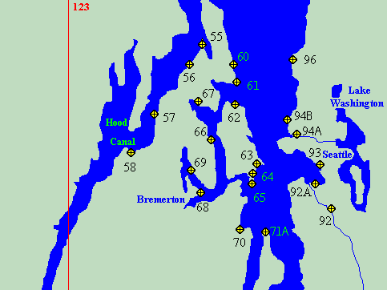
U.A. Army Corps of Engineers Tidal Benchmarks
http://www.nws.usace.army.mil/PublicMenu/Documents/Reg/applications/tides

Slide 27
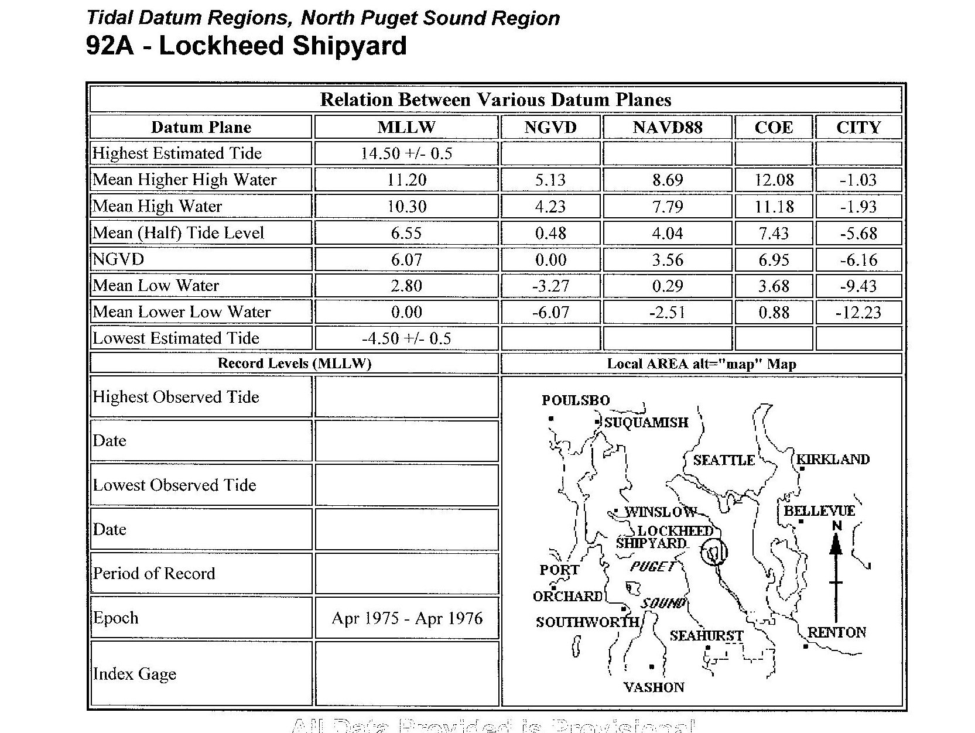

Slide 28
Navigable and Non-navigable Rivers and Lakes
In any survey of lands adjoining a river or lake one
of the first tasks of a surveyor is to determine if, in
face, the body of water is navigable or
non-navigable. In most cases this has already been
decided by court decision and the information can
be obtained from a title company.

Slide 29
For navigable rivers and lakes, the beds are
owned by the State of Washington with the
riparian land owner taking to the ordinary high
water mark.

Slide 30
For non-navigable rivers and lakes, the beds are
owned by the riparian land owner. As a general rule,
unless an intention to the contrary is indicated in
the conveyance itself, a grant of land bounded by a
non-navigable river will convey the land or bed
under the water to the thread.

Slide 31
The river or stream is regarded as a monument,
and the grantee takes to the middle thereof.
Various riparian owners adjacent to a non-
navigable lake take to the center of the lake in a
disposition equitable to all owners.

Slide 32
Non-navigable Stream
Lot 1
Lot 2
Thread
of
Lot 4
Lot 3
stream

Slide 33
Non-navigable Lake (Pie Method)
1
10
MEAN
HIGH
2
WATER
9
3
8
4
7
6
5

Slide 34
Non-navigable Lake (Long Lake Method)
2
1
3
MEAN HIGH WATER
LAKE
4
8
NON NAVIGABLE
7
6
5
PIE METHOD (TYP)

Slide 35
Additional Definitions:
Beds - That area where the action of the water is so
usual and long continued in ordinary years to mark
upon the soil a character distinct from the bank with
respect to the vegetation and the nature of the soil.

Slide 36
Bank – Usually that elevation along a river or
lake that equates to the line of ordinary high
water or the line of vegetation.

Slide 37
Ordinary High Water – The line where vegetation
ceases, or the line of ordinary high water
(sometimes called the high water mark, or mean
high water).
*This should not be confused with high waters due
to flood stage.

Slide 38
Thalweg – The deepest way or valley of a river bed.
Also referred to as the main channel.
Thread of the Stream – A line equidistant between
the lines of ordinary high water. It’s irrespective of
the thalweg line, which may be closer to one bank
that the other.

Slide 39
Location of Thalweg with Thread of Stream
Plan View
River bank (ordinary high water)
Thread of the Stream
Thalweg

Slide 40
Location of Thalweg with Thread of Stream
Cross Section View
Thalweg
Thread of Stream
Ordinary high water

Slide 41
Shifting Boundaries
by
the Change of Water Courses

Slide 42
Definitions:
Riparian – A riparian owner is one who owns
property along the banks of a water course and
whose boundary is the water in that course

Slide 43
Accretion – The gradual addition of soil of land
already in possession of an owner. It is the
gradual intrusion of the land area into the water,
Accretion occurs in two ways:

Slide 44
Alluvion – The washing up of sand or soil so as to
form firm ground.
Dereliction – When the sea or river shrinks or
withdraws below it’s usual water marks.
Note: The term alluvium is generally applied to the
deposit itself, while accretion denotes the act

Slide 45
Reliction – Land gained by the withdrawal of
water from the land. Example would be a Lake
drying up.
Erosion – Is the gradual eating away of the land by
rainwater, currents, or tides. It is the direct
opposite of accretion.

Slide 46
Avulsion – is the sudden removal of a quantity of
soil from the land of one person and its deposit to
the land of another, by the action of water. This
may be the sudden or rapid change in the course
of a channel of a river, or the sudden creation of a
new channel.

Slide 47
It is distinguished from accretion and erosion
by the time element. Avulsion is sudden;
erosion and accretion are gradual.

Slide 48
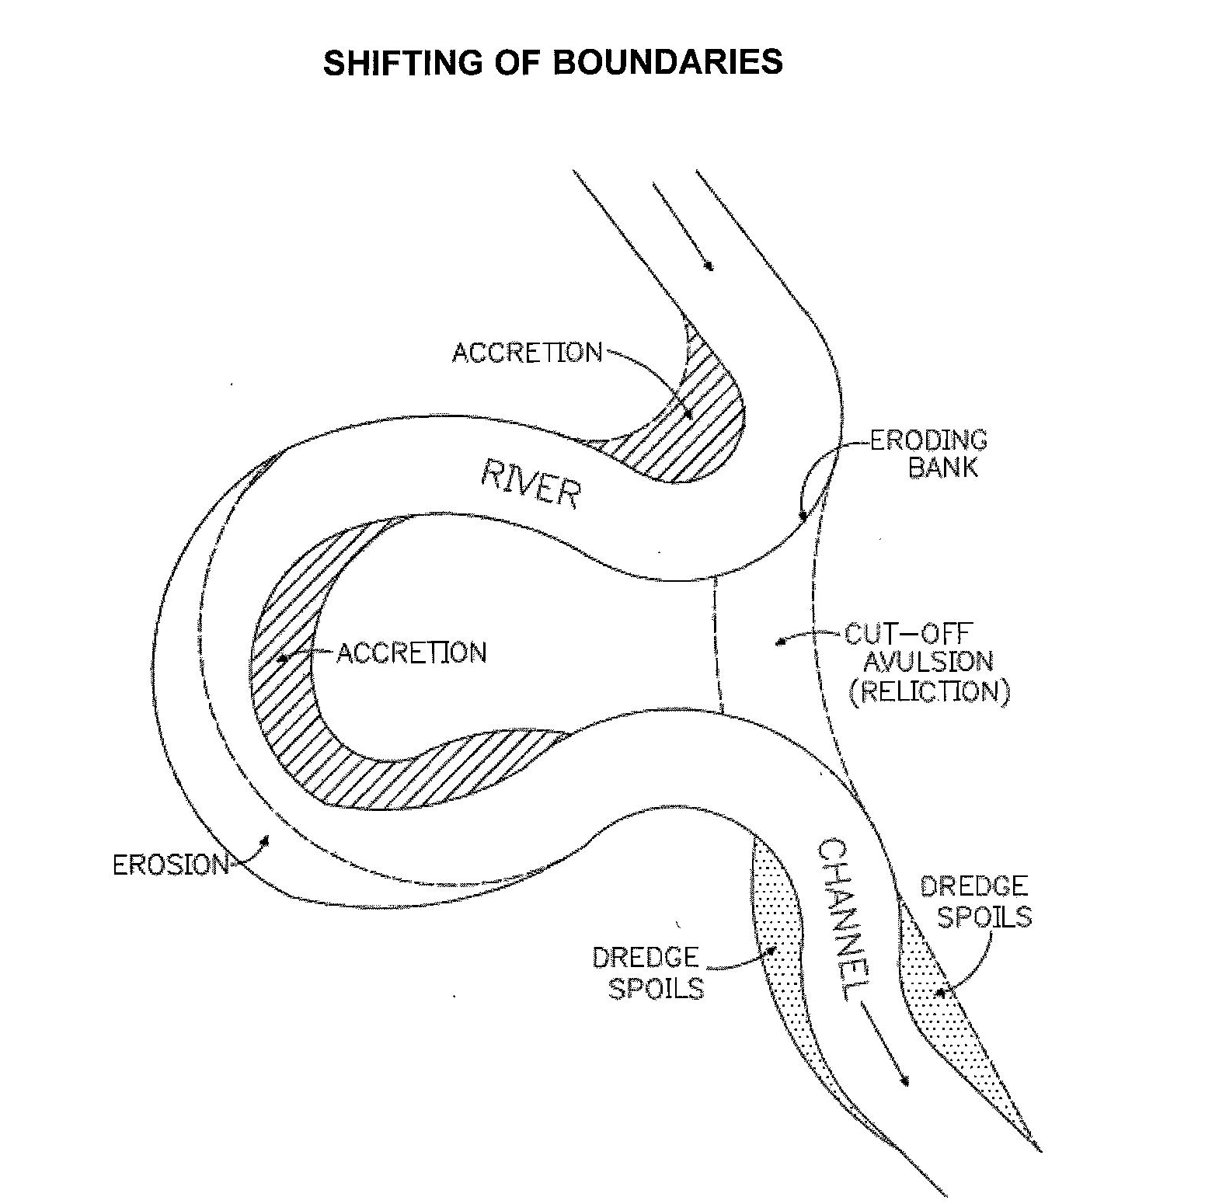

Slide 49
Lateral Boundary Lines:
A complex survey problem is encountered when
there is a need to ascertain and survey on the
ground the sidelines or lateral boundaries of
Tidelands or Shorelands ownership.

Slide 50
The general rule, as supported by court decisions,
is that in the case of a fairly straight beach the
property line extend at right angles to the beach
line. In the case of a cove or headland, however,
there are practical difficulties.

Slide 51
Here the general rule is that upland property
owners are entitled to a pro-rata or equal division
on the Tideland or Shoreland. This technique
involves extending the lateral boundaries at the
shoreline to proportionate widths of the frontage
at the line of extreme low tide, or, in the case of
Shorelands, the line of Navigability

Slide 52
Straight Beach
BEDS OF NAVIGABLE WATERS
LINE OF EXTREME LOW TIDE
a b c d e
SECOND CLASS TIDELANDS
A B C D E
LINE OF ORDINARY HIGH TIDE
1 2 3 4 5 6
UPLANDS

Slide 53
Cove Rule:
BEDS OF NAVIGABLE WATERS
LINE OF EXTREME LOW TIDE
a b c d e f g
G
A
F
B
2nd CLASS TIDELANDS
6
1
E
C
2
D
LINE OF ORDINARY HIGH TIDE
3 4 5
ag
AG
ab
AB
(AB)(ag)
AG
=
ab =

Slide 54
Headland Rule:
BEDS OF NAVIGABLE WATERS
EXTREME
LOW
OF
c
TIDELANDS
d
LINE
C
D
TIDE
CLASS
ORDINARY
a
b
e
f
2nd
HIGH
B
LINE OF
E
F
A
TIDE
1 2 3 4 5
af
AF
ab
AB
(AB)(af)
AF
=
ab =

